Slide 1
Validation Service
OPF Academy
Leszek Deska
20.02.2018

Slide 2
Agenda
Validation Service
Validation Service Architecture and Components
Configuration Details
Using the Validation Service
New approach - VTK
Notes:
Training will be split in four parts: first introduction to concept of payments validation, then we’ll present possibilities to configure Validation Service, practical information about using the validation service and finally new approach with Visual Tool Kit will be presented.

Slide 3
Validation Service - where it fits?
Notes:
The diagram shows internal components of OPF application. During typical processing of payments file an entry point is Interchange message queue. Reception of file from that queue triggers Message Driven Bean which launches Interchange Loader Service. This service loads message into database and triggers parsing by posting a message on Parsing Queue. Just like for interchange loader, here as well Message Driven Bean is triggered which delegates processing to Parsing Service. Last action exectued by Parsing Service launches BPEL flow.
(click)
Validation service, just like many other OPF services, is run from BPMN flow which orchestrates OPF services. Validation service only validates the payments but does not take any actions – in case of any problems detected Validation Service will only raise an issue. One issue is raised for each validation rule that failed. All those issues (which are of class GenericIssue) are wrapped in single object GenericIssueLog and returned to BPMN flow. The flow then passes this object to Issue Processor Service which analyses all issues raised and (according to it’s own configuration) takes appropriate actions.
Similar approach is used for other OPF services: they do not take action, only raise issues which are late analyzed by Issue Processor which takes appropriate actions.

Slide 4
Architecture

Slide 5
Validation Service
Responsible for applying a series of business validation logic (rules) against an object
Works on OPF payment entities
Works on transient objects as well
Driven by XML configuration
Using OPF configuration framework
Build on standard J2SE/J2EE technologies
Stateless session bean defines synchronous interface
Underlying infrastructure is based on POJOs and configuration files
Framework consist of different components
Validators, SetValidators, Conditions, Validation Context Populators and configuration settings
Notes:
(click)
Validation Service applies business validation logic against payment entities. That logic is applied in form of validation rules, rules might be applied to persisted entities but might be also applied to not yet persisted (transient) entities as well.
(click)
Validation Service extensively uses XML configuration. In fact in almost each case it’s just enough to configure that service, there should be no need to customize the service with Java classes, except for custom, project-specific validation rules.
(click)
Validation Service is implemented as stateless session bean, it’s underlying infrastructure is based on POJO - Plain Old Java Objects and XML configuration files.
(click)
During this training we’ll describe all the components that form Validation Service: validators, conditions, populators and others.

Slide 6
Validation Service - invocation
For persisted entities
BPMN
invokes
Validation Service
returns IssueLog
passes
IssueLog
Issue Processor
Service
Uses to create history message
Payment History
Service
For transient entities
OVA/BVA
Validation Service
Notes:
For persisted in database entities the flow of control is as presented:
(click)
BPMN flow calls the validation service, passing as parameters entity key and optionally a collection name. If no collection is provided then default collection will be run.
One quite obvious thing is worth mentioning: the validation service should not change the payment in any way, it should only validate it. In case of any failed validation rule an issue is raised and all the issues, wrapped into GenericIssueLog object are returned to the payment flow.
(click)
BPMN flow in next step launches Issue Processor, passing GenericIssueLog (received from Validation Service) as input parameter to Issue Processor. It’s the duty of Issue Processor to take actions basing on issues raised by Validation Service. This pattern applies to any OPF service run from BPEL flow.
Issue Processor will take actions
(click)
And will generate Payment History entries to keep track of issues raised by Validation Service.
(click)
For entities which are not persisted (are transient) the flow of control is different. This mechanism is used only from web tier – from BVA (Bank Visibility Application). In such case those transient entities are passed to the Validation Service, unlike it’s with persisted entities where we only pass to Validation Service the entity key and entity type.

Slide 7
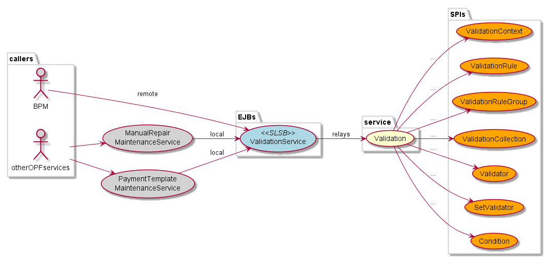
Validation Service - invocation
Notes:
Validation Service is called either from BPMN flow (then it validates persisted entities) either from other OPF services. In second case Validation Service might validate persisted or transient entities, depending which method is used. Validation Service is implemented as a stateless session bean which delegates validation functionality to a java class implementing validation functionality. Internal components of validation service will be discussed next. All those components are implemented as SPI’s – configurable through xml file. You can see a list of those SPI’s on this slide.

Slide 8


Validation Service Components
ValidationService
ValidationServiceBean
delegates to POJO
Validation
ValidationContext
intializes
and
uses
StandardValidation
StandardValidationContext
Notes:
This slide explain internal components of Validation Service which is typical for OPF services. ValidationServiceBean implements interface (click) ValidationService.
It delegates it’s calls (click) to POJO – Plain Old Java Object which is (click) StandardValidation in OPF layer.
(click)
ValidationContext interface and it’s implementation (click) StandardValidationContext are used to interchange data between validation service internal components.
Validation Service default implementation is highly configurable so projects usually do not override the service itself. Instead of that it’s enough to configure it – by adding new validators.

Slide 9
Collections, Rules, Groups Conceptual View
Collection
1
N
Group
1
1
0
Condition
N
0
Rule
1
Notes:
Validation of entities is done per collection.
(click) Validation collection is a set of Validation Groups.
(click) Validation group is a set of Validation Rules.
Validation rule is single check of one business, functional requirement. For example a test if payment transaction attribute named „processing scheme” exists. In case if it will be empty that validation rule will fail resulting in raising of an issue. Validation Service will continue checking remaining validation rules in this group, then all remaining validation groups in the collection being validated and all the issues raised together will be returned to the caller (BPMN or web tier).
(click) group or rule might define a condition. Validation Service will first test the condition and will skip current step if condition will return false.
For example: if condition defined for validation group is not met (evaluates to false) then such group will not be validated (meaning no issues will be raised for sure). Same applies to a validation rule – there is no validation run when condition is not met.

Slide 10
Validators
Validators execute piece of validation logic which is applied to a single object
Check field value or format, mandatory fields, regular expressions, match expected set of values, …
Validators can specify location of target field(s) and expected values / formats / regular expression in config file
Validators are implemented as Java class and configured in validationservice-projectname-types.xml
SetValidators applies to set of entities
Notes:
Validation Rule logic is executed by validator. In case when there is no condition on validation rule or the condition returned value „true” then validator defined in validation rule is run.
(click)
Validator executes single business validation on one object. It might test for example if value is present on entity, if it matches some format etc.
(click)
Validators should be configurable - to be reusable. They should expect in it’s own configuration things like: location of fields to be validated, values to compare, functional switches to control inner workings. This will allow to avoid implementing separate, similar validators.
(click)
Validators are java classes which are listed in configuration of validation service with some unique name. That name is later used in each validation rule to point to specific java class to run.
(click)
SetValidators allow validation of set of entities. Consist of pre-processing step, a validation rule applied to each entity and a post-processing step. It’s state is maintained across element traversal but not between invocations of Validation Service.

Slide 11
Validators
Should extend AbstractValidator class
Must have validate() method to execute validation logic
Can have configure() method to obtain parameter values from configuration file
Custom parameters can be used in config file
Parameters may be a string value or comma-delimited string array
Parameter name must match name used in configure() method
Validation framework will instantiate, configure and cache all Validators when the service is called for first time ! (like any other SPI)
Notes:
(click)
Validators must extend AbstractValidator. The method validate will do the actual valdiation. Method configure will be launched when first time validation service will try to use that validator. Use this method to configure the validator – read fromconfiguration of validation rule all the configuration settings supported by your class. You might reuse them later in validate method.
(click)
Please remember that validators must be stateless. They’re instantiated, configured and cached only once – when the service tries to use them for the first time. To pass values you willb e using ValidationContext (explained later).

Slide 12
Issue Generation
Validator raises issues when it’s validation failed
Used to communicate to caller what problems were found
To raise issue, Validator must specify
An issue name – must match issue name specified in config file
A table of parameters – to fill in the generic issue message with data specific to the issue raised
Validator calls raiseIssue() on ValidationContext
Validator stops validation logic and returns
assuming one issue is raised at a time by a Validator
An issue mapping must exists in configuration of validation rule for every issue that might be raised
otherwise exception is thrown
Notes:
(click)
Validator does not take any action and does not modify in any way entity it validates. If it finds data incorrect it just raises an issue. That issue will be transported to the caller (possibly together with other issues which were raised in the same call to Validation Service.
(click)
Issue raised must have name and optionally might have table of parameters. Name identifies type of issue, parameters are later used to fill in the message shown to the user with specific data for this particular issue.
(click)
To raise an issue validator must call raiseIssue method on ValidationContext. One validation rule might raise only one issue per one execution. It might however raise different issues depending on type of problem it encountered. For example validator checking format of some attribute might raise issue „no value” or issue „incorrect format”. Each name of issue type raised must be configured in configuration of validation rule using that validator. There must be mapping of that issue name to domain and number of issue transferred later to Issue Processor.

Slide 13
Conditions
Provides conditional logic to determine if Validation rule or Validation rule group should be executed
Conditions might be grouped into logical sentences (using AND, OR)
Condition types
single conditions – evaluate XPath expression against target entity, document or field – Must return TRUE to trigger rule
composite condition – evaluate child conditions – all must return TRUE to trigger rule
or condition – evaluate child conditions – at least one must return TRUE to trigger rule
conditions might be grouped into logical sentences like: c1 and (c2 or c3)
Create new conditions by extending AbstractCondition
Implement holdsTrue() and configure() methods
Notes:
(click)
Conditions are tested to determine if validation rule or validation group should be executed or not. It might be single condition or a group of conditions.
(click)
Single conditions are of predefined types. Just like validators, also conditions are configured in validation service configuration – each name of condition is mapped to a java class. That java class is instantiated and run to fetch the result of condition. Those conditions might test if value exists, if it is in some format, if is in some range (if it’s a number) etc.
Conditions might be grouped into logical sentences, also several times – using types „composite” for logical conjuction and „or” for logical alternative.
(click)
Java class implementing condition should extend AbstractCondition, implement holdsTrue method which will actually return value of condition and configure method which will read configuration of this condition. Just like validators also condition must be stateless as it will be instantiated, configured and cached at first it’s use.

Slide 14
Configuration

Slide 15
Configuration Concepts
Configuration file validationservice.xml contains following sections:
Generic Validation Service configuration
Validation Rule Group definitions
Validation Rule definitions
SetValidator Rule definitions
Validator type definitions
Condition type definitions
Notes:
(click)
Configuration of Validation Service is done through validationservice dot xml file. As other services configurations that file is merged in memory from multiple configuration files. Those files are split in order to allow easier navigation for developer but also because some of those files are generated and some written by hand.
Validation service configuration consists of sections for:
(click) generic validation service configuration – usually defined on OPF level and not modified on project level
(click) validation rule group definitions – almost completely generated from VRGT – Validation Rules Generation Tool, which is described in detail in separate training
(click) validation rule and set validation rule definitions – also almost completely generated from VRGT.
(click) validator type definitions – written by hand, only for custom, project-level new validation types. Generic types are already defined on OPF or product level
(click) condition type definitions – just like for types of validation: only new, added on project level conditions must be added in configuration

Slide 16
<validationservice> tag
<validationservice>
Name | Type | Mandatory | Description
id | Attribute | Yes | This is an attribute of the validationservice parent element. Unique identifier for the service e.g. "default„
name | Element | No | Name, might be fully qualified class name of the Validation Service
classname | Element | Yes | Fully qualified class name of the Validation Service implementation
issuelimit | Element | No | Defines the maximum number of issues the Validation Service may throw before ceasing to process any further validations.
Notes:
Validation service tag is the root configuration tag for whole validaton service configuration. All other tags discussed later are included within it.
(click)
Id attribute is an unique identifier, please make sure you use the same as on product layer if you want to override the configuration on project layer.
Name attribute should be unique, it might be the same classname attribute which is a fully qualified class name of the Validation Service implementation. It’s best not to override validation service to avoid regressions and incompabilities with future OPF versions. Validation Service is so customizable through it’s configuration that overriding that service shouldn’t be needed – please check all options first before you decide to override it.
Issuelimit attribute is optional, it might be used to restrict maximum count of issues raised before validation service will stop the processing.

Slide 17
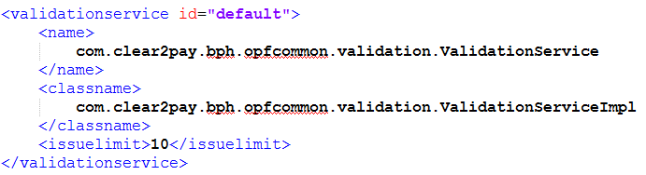
<validationservice> - example
Example from validationservice-opfcommon.xml
Notes:
This example shows the default configuration of validation service – from OPF layer, exactly from OPF Common part.

Slide 18
<validationcollection>
Collection of groups that are to be executed
If no collection to run is specified when calling validation service, then default collection is run
Default collection contains all default validation groups
Element <default> controls whether validation group is a default one. If it’s not given then group is default
When collection is executed, groups are validated sequentially as listed in configuration file
Collections can not specify condition
Notes:
(click)
Validation collection is a set of validation groups.
(click)
Validation Service might be run with name of validation collection to execute or without it. When collection is specified then only that one collection will be run. When there is no collection specified, then default collection of validation groups is run. Default collection of validation groups is constructed in runtime by using all validation groups which has element „default” set to true or has no element „default”. It means that in order to exclude validation group from default collection developer must explicitly specify element „default” with value „false”.
(click)
When collection is run then all validation groups it contains are run one by one. Potential issues raised during that process are cumulated and returned to the caller afterwards.
(click)
Collections may not contain a condition. However groups included in it might – it will be discussed later.

Slide 19
<validationcollection>
<validationconfig><service><standardvalidation><validationcollection>
Name | Type | Mandatory | Description
id | Attribute | Yes | This is an attribute of the validationcollection element. Unique identifier for the collection. Collection is invoked using id.
classname | Element | No | Refers to the class to execute. ValidationRuleGroupCollection is the OPF provided class for this.
group | Element | Yes | A repeating occurrence, specifying the validationrulegroup that is to be executed
Notes:
Validation collection configuration tag should be included within standard validation tag, just like all other configuration nodes. It should contain:
(click)
Attribute id is mandatory and must be unique. Please use some descriptive value for id.
Classname is the java class implementing logic of validation collection. This training assumes that OPF layer implementation of validation collection is used.
Collection might contain one or more groups which are just enumerated with their id, all those groups must be separately configured, otherwise validation service will throw an exception. Configuration of groups will be disussed just after collection.

Slide 20
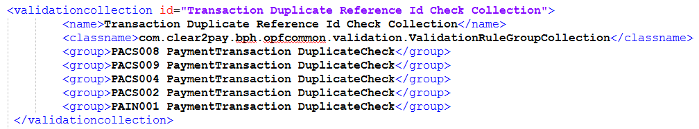
<validationcollection> - example
Notes:
This is a real life example of validation collection configuration. Collection may not contain a condition, so each time when it’s triggered it will cause that all those five validation groups included in this collection will be run.
As mentioned earlier validation collections, just like groups and rules are in most cases (like 99%) generated by Validation Rules Generation Tool. Only few specific validation rules like duplicate check or timeline validation are configured by hand.

Slide 21
<validationrulegroup> tag
Groups related validation rules, that should be executed as a single validation unit
Each rule is specified by name and id
If required, condition may be specified for the validation rule group
Group is executed only if condition is met
When group is executed, rules are validated in sequence as listed in configuration file
Even if some rule will raise an issue, all the rules will be executed from all group in collection being validated
Validation groups can NOT contain other groups
Notes:
(click)
Validation groups contain validation rules which are related to each other and run together. For example validate the same type of input file, let’s say pain.001.
Validation group lists those rules by their id and name.
(click)
Validation Group might define condition – if it is met, then group is launched. Otherwise this group will not be triggered, meaning that no validation rules from that group will be validated and no issues will be raised. Not met condition results then in a successful validation of a group.
(click)
When group is triggered then validation service runs sequentially each rule from that group. Any potential issues raised by validation rules are cumulated and returned together, not stopping the processing.
(click)
Validation group might contain only single validation rules, not other groups. Only collections might contain groups.

Slide 22
<validationrulegroup>
<validationconfig><service><standardvalidation><validationrulegroup>
Name | Type | Mandatory | Description
id | Attribute | Yes | This is an attribute of the validationrulegroup parent element. Unique identifier for the rule.
default | Attribute | No | Controls wheter validation group is a default one (run when no collection is specified)
name | Element | Yes | Descriptive name for the rulegroup. Deprecated – replaced by id
type | Element | Yes | Refers to the ValidatorRuleGroup class to execute.
condition | Element | No | The condition that must be met to proceed with the execution of the ValidationRuleGroup.
validationrule | Element | No | A repeating occurrence, specifying the validation rule that must be executed
<validationconfig><service><standardvalidation><validationrulegrouptype>
Name | Type | Mandatory | Description
id | Attribute | Yes | This is an attribute of the validationrulegrouptype element. Use it in <type> element of group
classname | Element | Yes | Java class implementing that rule group
Notes:
(click)
Validation rule groups are configured in xml node validation rule group. Attribute id must be unique among all validation groups.
Attribute „default” controls wheter validation group is a default one, meaning it will be run when Validation Service is launched without specified name of collection. When there is no value specified for this attribute then group is considered as default.
Elements within that tag are:
Name – deprecated, replaced by id
Type – should refer to separetely defined validation rule group type tag which will be described in a moment
Condition which controls if validation group will be launched
validation rule elements which list one by one all the validation rules included in this group
If condition is not met then whole group is skipped and no validation issues will be raised.
(click)
Validation rule group type configuration links type of validation group mentioned moment ago to a java class that will implement it’s logic. This training assumes that OPF implementation is used.

Slide 23
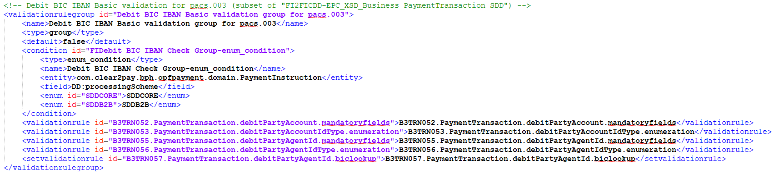
<validationrulegroup> - example
Notes:
This slide presents example of validationrule group.
First part is a generic configuration of type of validation group - it’s the java class, which implements logic of validation group in OPF layer. It must be defined only once and it is defined on OPF level (no need to repeat that on project level).
(click)
Next we see a configuration of validation group. The group contains one condition which ensures that rules contained in thi group will be launched only if instruction to be validated has processing scheme SDDCORE or SDDB2B.

Slide 24
<validationrule> tag
<validationconfig><service><standardvalidation><validationrule>
Name | Type | Mandatory | Description
id | Attribute | Yes | Unique identifier of the rule. This is referred to when including the validation rule in a validation rule group.
name | Element | Yes | Descriptive name for the rule, must be equal to the id in default OPF implementation: com.clear2pay.bph.opfcommon.validation.AbstractValidationRule
type | Element | Yes | Refers indirectly to the validator class to execute. The actual value in this element refers to the validation rule type specified separately in validation service configuration. Analogically as for validation group.
entity | Element | No | Domain entity the rule will be executed against.
condition | Element | No | The condition that must be met to proceed with the execution of the validation rule.
issue | Element | No | A repeating occurrence, specifying an issue raised upon failure of a check in the Validator.
Notes:
Each validation rule must be configured by <validatiorule> tag.
(click)
In default OPF implementation of basic validation rule class the attribute „id” and element „name” must contain the same value. Please use some descriptive text for that.
Type of validation refers to java class which will execute the actual validation. This tag contains name of type which is separately mapped in configuration to a java class, just like it was presented on previous slide for validation group.
Entity tag defines for which type of entity this validation rule is defined. Validation Service will run this rule only if it’s run for the same type of entity. Type of entity is an input parameter to all validation service methods.
Condition works analogically as for groups. It must be met in order to run the validation rule. Otherwise rule is not run, no issues are raised and validation is successful.
One or more tags named „issue” define all possible isseus to be raised by this rule. Please note that during each run validation rule might raise multiple issues but it’s not adviced, recommended approach is to raise only one, most important issue from one validation rule.

Slide 25
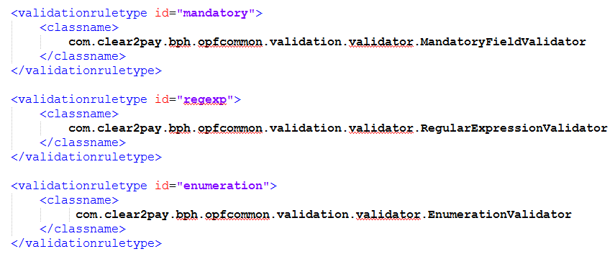
<validationruletype> - example
Notes:
The mapping between type of validator and java class is done using validation rule type tag. Here you can see three examples. Validation rules will contain only the content of „id” atribute from this slide, what we will see on next slide.

Slide 26
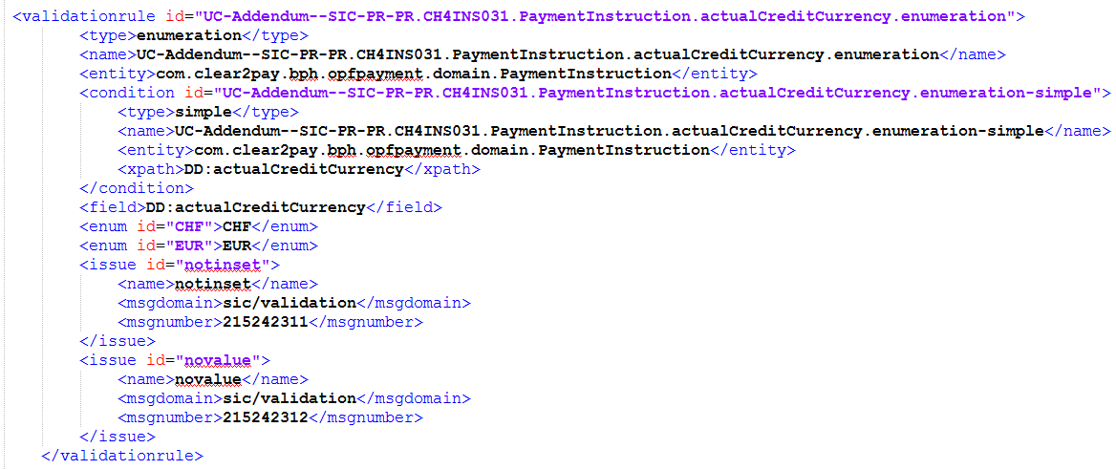
<validationrule> - example
Notes:
The example presented on this slide presents validation rule configuration which has a condition ensuring that rule will be validated only if attribute actualCreditCurrency is present. The rule will then validate if attribute actualCreditCurrency is within a set of CHF and EUR.
If the value validated is not in that set then issue „notinset’ will be raised.
Please note that if actualCreditCurrency attribute is empty then no validation will be performed and no issues will be raised. Still you can see that configuration contains „novalue” issue. It’s caused by fact that validation framework checks if configuration of validation rule covers all possible issues raised by them. Thanks to this check if there is a misconfiguration then it will be detected upon first call to validation service and not when that specific validation rule is triggered and that missing issue is raised.
Such misconfiguration is detected at startup of Validation Service what is more reliable. In such case an unchecked exception will be thrown.

Slide 27
Out-of-the-box Validators
extend
com.clear2pay.bph.opfcommon.validation.AbstractValidator
examples
DateFieldFormatValidator
DateRangeValidator
EnumerationValidator
IBANFormatCheckDigitsValidator
MandatoryFieldValidator
NotPresentValidator
NumericRangeValidator
PredicateValidator
RegularExpressionValidator
Notes:
When ever possible please reuse existing validators from lower layers, like OPF, SEPA or XCT. The reason is that they are well tested, documented and will take much less time to be configured than new validators to be written from scratch, tested and integrated with your application.
All the validators extend the same abstract java class: AbstractValidator.
Examples presented here have self-explaining names but also contain extensive java-doc not only with explanation of it’s functionality but also with snippets of xml configuration which might be used to configure such validator on project layer. Please follow the same principles when adding own, custom validators: self-explaining name and java-doc with description and configuration example. If possible use existing validators or extend them.

Slide 28
Out-of-the-box SetValidators
com.clear2pay.bph.opfcommon.validation.AbstractSetValidator
OPF Core
CountValidator
SumValidator
OPF SPEX
BICTableLookupValidator
BusinessDayRangeValidator
ISOCodeValidator
UniquePaymentEntityValidator
UniqueTransactionValidator
Look in javadoc for more details
Refer to OPF and product level configuration: validationservice.xml
Notes:
The same as for validators applies to set validators, which are as mentioned earlier special validators capable to validate set of entities. Please use existing set validators if possible – to check the functionality of existing set validators please refer to their java doc. To get full list of implemented validators and set validators please look into configuration file from OPF and product level. Name of wrapper file is validationservice.xml

Slide 29
Out-of-the-box Conditions
com.clear2pay.bph.opfcommon.validation.AbstractCondition
OPF Core
CompositeCondition
EnumerationCondition
OrCondition
RegularExpressionCondition
OPF SPEX
FieldsComparisonCondition
FileFormatCondition
InstructionTypeCondition
NotPresentCondition
OutboundCondition
Look in javadoc for more details…
Notes:
Finally the last component – existing conditions. Again the same principle – name should explain what that condition is checking, java doc should contain description of functionality and snippet of configuration presenting how to configure that condition.
Abstract java class contains common logic, extending classes contain only the logic of that particular condition.
Except for some project-specific logic you should find all needed conditions already implemented on OPF and product level. Please refer to java doc of those classes.

Slide 30
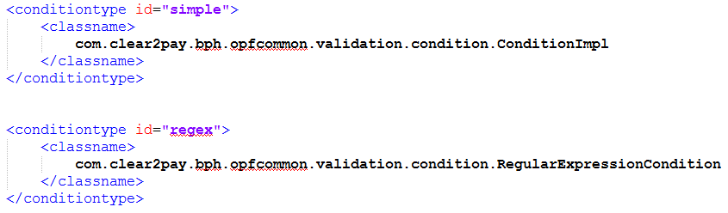
<conditiontype> - example
Defined in validationservice-*-type*.xml files
Notes:
Condition types are configured in validation service configuration files, we put them in file with word „type” inside. Configuration links type of condition to java class which implements that condition. Later in configuration of validation rule or group only that type is used.

Slide 31
Using Validation

Slide 32
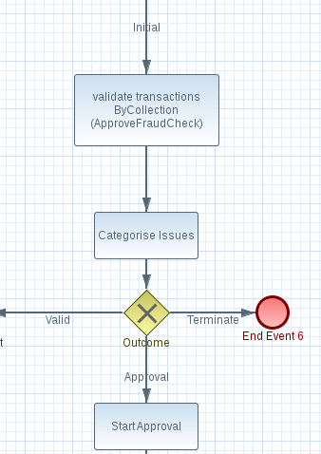
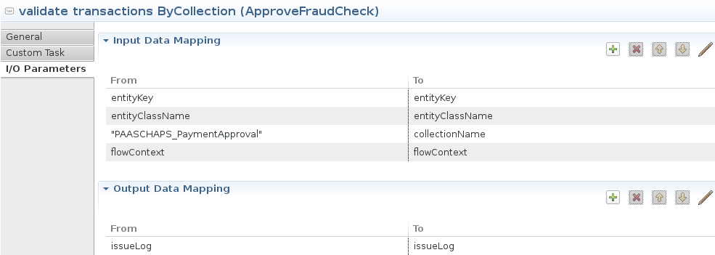
Validation Service Invocation - BPMN
Notes:
To invoke validation service from BPMN flow you need to drag and drop that service into desired place of the flow.
(click)
Then you need to choose input and output parameters – click on validation service and and in properties window at pane “I/O Parameters”. Specify parameters, especially name of collection to be used.
(click)
Please remember about adding Issue Processor step after call to validation service (categorise operation) and to take correct action basing on output of categorization of issues raised by validation service.

Slide 33
Validation Service and VRGT
Almost whole validation service configuration is automatically generated by VRGT
Do not edit VRGT-generated files!
Changes to VRGT-generated files should be done first in specs by BA, then DEV triggers VRGT
Refer to separate elearning on VRGT for more info (introduction and second, more technical for DEV)
How to recognize VRGT-generated file:
by name: validationservice-vrgt-*.xml
by content:
<?xml version="1.0" encoding="UTF-8"?>
<!-- Do not edit, file generated -->
<validationconfig>
Notes:
Please remember that in most cases (unless VTK is used, what is explained in last chapter of this training) vast majority of validation service configuration is generated by Validation Rules Generation Tool (VRGT). You should not edit those generated files as VRGT is being regenerated systematically and your changes would be lost after regeneration of validation config. Instead of manual modification of those files you should contact Business Analyst, he needs to modify the input file (located in „Addendum” directory of use cases) and then when he corrects the specs you might regenerate VRGT. That will create new version of VRGT-generated files and hopefully will fix the issue.
How to recognize files generated by VRGT? It’s very simple as they all have name starting with „validationservice dash vrgt”. Content begins with an xml comment saying „do not edit, file generated”.

Slide 34
Adding custom validator and condition
Steps to add new, custom validator with condition and use it
Write java class extending AbstractValidator and implementing the validation logic
Configure new type of validator
Configure validation rule using that new validator type
Use new validation rule in some validation group
Optionally you might create new java class for condition
Then configure new condition type
Add usage of that new condition type inside of validation rule added previously
Notes:
Next four slides will present an example of how to add a custom validator with a condition.
Generally you need to:
Create java class which implements requested logic
Configure that new class – define name for that type of validator
Configure validation rule that will use new type of validator
Finally use that rule is some existing validation group or add new group for this rule
If you need to add some condition to control when validation will be run then look at existing conditions o OPF and product leve. In most cases you’ll find already written condition that will suit your needs. In case of project specific conditions you might of course add new type of condition. In order to do so you need to:
Write new java class to implement the condition
Configure that new class as a condition type
Add inside of validation rule configuration <condition> tag referring to new type of condition

Slide 35
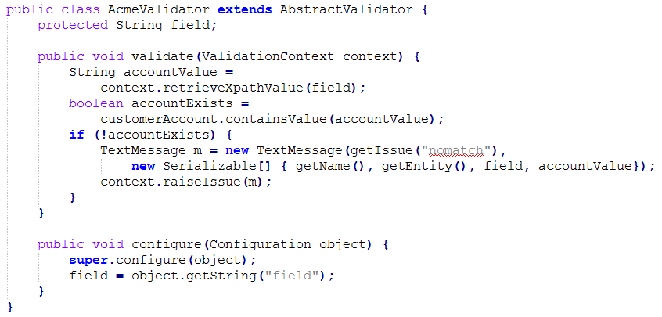
Creating a Validator
Notes:
When writing new validator you need to extend AbstractValidator class. Two most important methods are:
Configure – where you should read from configuration all the values taht will later control the validation
Validate – where you need to implement the validation logic requested. In case of successful validation this method should complete with no information returned to the caller. In case of failure you need to raise an issue by using validation context – method „raiseIssue”.

Slide 36
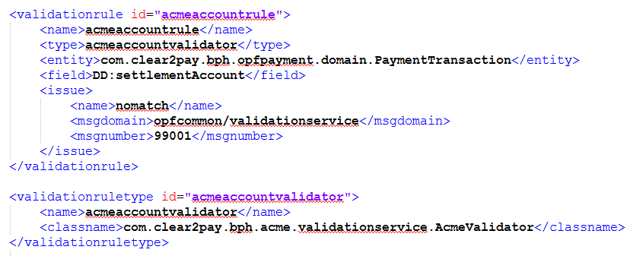
Configuring a Validator
Notes:
Next you have to configure new validation type – see the tag „validationruletype” at bottom. Now you might use that new type to configure whole validation rule as presented.

Slide 37
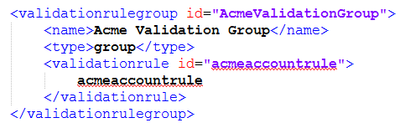
Messages and rule usage
validationservice-acme.properties
99001=error, Account number {3} is invalid !
Use rule in <validationrulegroup>
Notes:
Finally you need to add property that will be used to present message for issue raised by our new validation rule.
Now the validation rule is ready.
(click)
You might plug it into any validation rule you need.

Slide 38
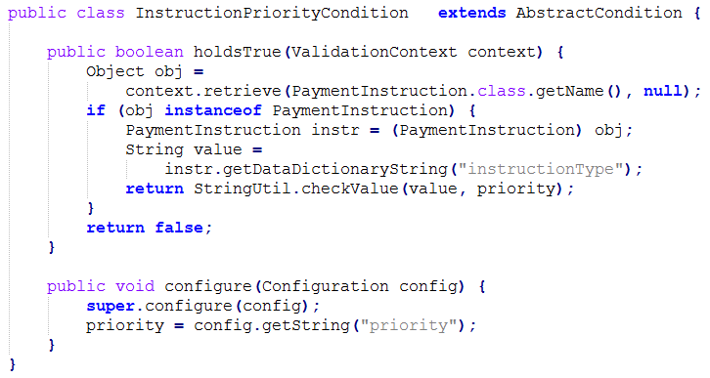
Create a Condition
Notes:
In case if you would need to add project specific condition for validation rule please follow analogical procedure.
Write java class to implement that logic – extend AbstractCondition, use „configure” method to read values from condition’s configuration and „holdsTrue” method to do the actual check for condition. That method should return primitive boolean. True means that codition evaluated to true – validation rull will be run. False means that validation rule will be skipped.

Slide 39
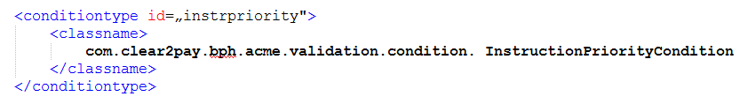
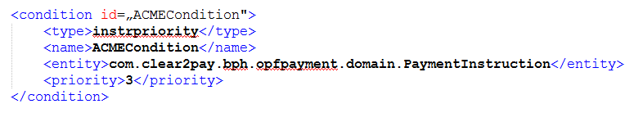
Configure the condition
Add it as a condition in validation rule – inside <validationrule> tag
Notes:
Next define the condition type – linking condition name with java class implementing it.
(click)
Now you may add that condition to any validation rule
(click)
You just need to add <condition> tag inside of that validation rule. Usually we add that just after type of validation rule.

Slide 40
VTK and Validation

Slide 41
Validation Service - VTK
Validation Rules are defined using Business Rules Expression Framework (BREF). BA inputs them using VTK.
Validation Rules are grouped into Validation Groups which are further grouped into Validation Collections. They are also configured by BA using VTK.
Each Validation Rule has one Validator which might raise an Issue if it’s internal logic will detect a problem with a payment. This works the same as in „standard” approach explained in previous slides.
Notes:
New approach to configure Validation Service is to use VTK – Visual ToolKit. In that approach BA (Business Analyst) defines Validation Rules, Groups and Collections.
Validation Rules are defined using BREF – Business Rules Expression Framework.
(click)
Validation Groups are defined by selecting Validation Rules which belong to that group.
Validation Collections analogically are grouping Validation Groups.
(click)
The way Validation Rule works is the same as described earlier, only method of defining the rule is different.
Theoretically there should be action needed from developer side apart from running the VTK to generate input for Validation Service. In practice – BA sometimes needs help to implement Validation Rule or debug why it doesn’t work as he thought it will.

Slide 42
Validators
Validators are reusable functions that execute business checks. Validators might be defined in two ways: - using BREF - using Java
To see all Validators double click Resources/Validators.xml
Validators in blue belong to active distribution and might be modified.
You might add or modify Validators
Field Binding Method defines type of Validator. Choose Script for BREF-defined validator. VTK will provide syntax checking.
Notes:
Validators are reusable functions that execute business checks. They might be implemented in two ways: as a BREF expression or using a link to a Java code.
In first case it’s the Business Analyst who defines the validator – in VTK.
In second case it’s the Developer who implements in Java the code doing the business check.
(click)
Opening validators page in VTK will show window with all validators listed (of both types).
(click)
Double clicking any validators shown in blue color will open a page where it might be modified.
(click)
Adding or modifying a validator works the same –at that stage BA provides information how business logic behind this validation rule will be implemented.

Slide 43
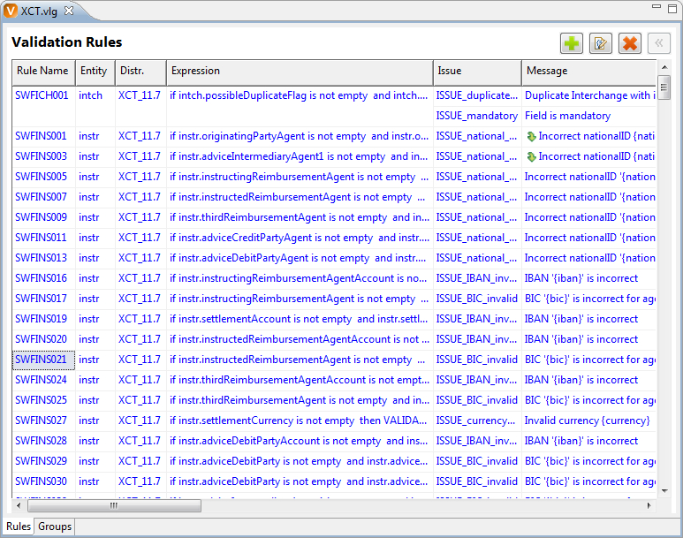
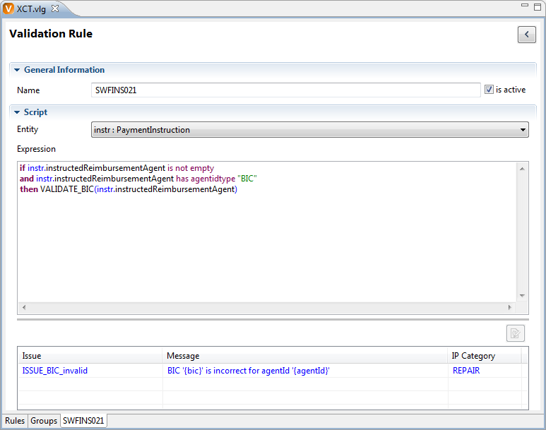
Validation Rule
Operates on one entity (column Entity)
Is expressed using Business Expression Syntax (column Expression)
Might raise an issue (column Issue) which will be later processed by other component – Issue Processor
VTK provides support for entering Validation Rule – syntax checking, auto-completion
Notes:
Validation Rules might use defined already Validator or provide own script in BREF to define the logic.
(click)
This image presents how Business Analyst provides the input for Validation Rule.

Slide 44
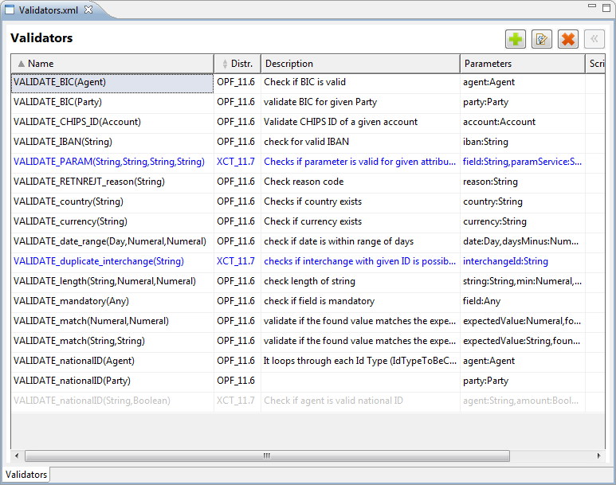
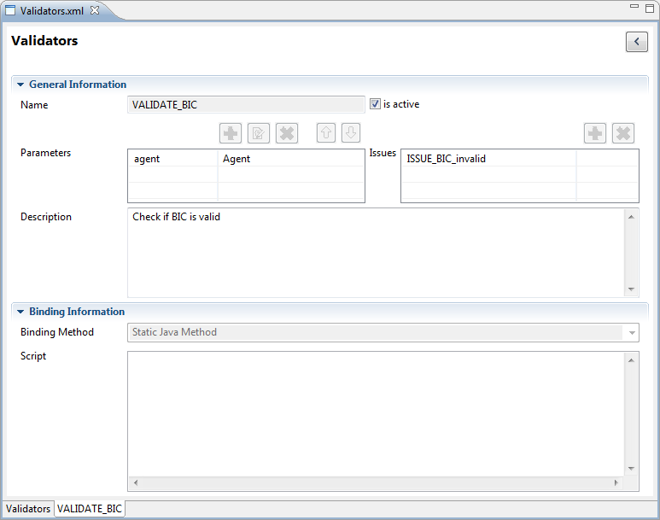
Validators
Java based Validators are reusable functions that execute more complex business checks. They are implemented by developers and defined in VTK for BA to be used when creating Validation Rules. They have input and output parameters. New validators might be added (with help of developer).
Notes:
Java based Validators are used for more complex business checks. They are implemented by developers based on documentation prepared by Business Analyst and defined in VTK for BA to be used when creating Validation Rules. They have input and output parameters.
New validators might be of course added (with help of developer).

Slide 45
Validation Groups
In order to more efficiently manage numerous Validation Rules a concept of Validation Groups has been introduced. Groups might have an expression which will be checked first. If it’s not true, then whole group will be skipped, otherwise all Validation Rules from this group will be executed.
Condition is visible in “Expression” column
For “Group” rows
Notes:
Validation Groups might be defined using separate tab of page for Validation Rules.
(click)
Tab is called “Groups”.
(click)
Each group might have a condition. If condition is not met then whole group is skipped and as a result no issue will be raised.

Slide 46
Validation Groups
All created Validation Groups will be visible at Validation Rules screen as columns. You might assign each rule to any count of groups.
Notes:
Back to first tab “Rules” it’s possible to see that each added Validation Group will have a corresponding column of checkboxes.
By checking some of them Business Analyst might group any set of rules into one Validation Group. It’s a many to many relation as one Validation Rule might be part of many Validation Groups and vice-versa.

Slide 47
Validation Collections
Validation Groups might be further grouped into Validation Collections. Such solution allows to run Validation Service with single parameter (a collection) that will run several groups (pre-condition on each group is checked first).
Checking checkboxes allows BA to select which validation groups will belong to which collections.
Notes:
In a very similar way Validation Groups are grouped into Validation Collections. The difference is that Validation Collection may not have a condition defined.
The reason is that Validation Collection is the input parameter for Validation Service. It will be run then – service will iterate through all the groups in given collection and then through all rules in each Validation Group. On both level first condition will be evaluated (if provided).
(click)
Collections will appear as columns at “Groups” tab of Validation Groups page. Analogically like on previous slide such mechanism allows to assign validation group to many collections and to have many groups in the same collection.

Slide 48
Generate Validation Code
To activate the generator click Run > Validation > Generate Validation Artifacts
For details on integration of the generated files see the OPF Developer Guide
Files that will be generated:
• validationservice-vsdk.xml
• isssueprocessor-vsdk.xml
• validationservice.properties
• message files, Issue definitions
Notes:
Developer activity in new approach should be limited to generation of Validation Service artifacts straight from Visual ToolKit. Those artifacts should be then copied to our application sources, tested and checked in. For detailed information on how to incorporate generated by Visual ToolKit artifacts into our application’s sources – please refer to OPF Developer Guide.

Slide 49
Thank you
Notes:
Thanks you for your attention.

